Slide 1
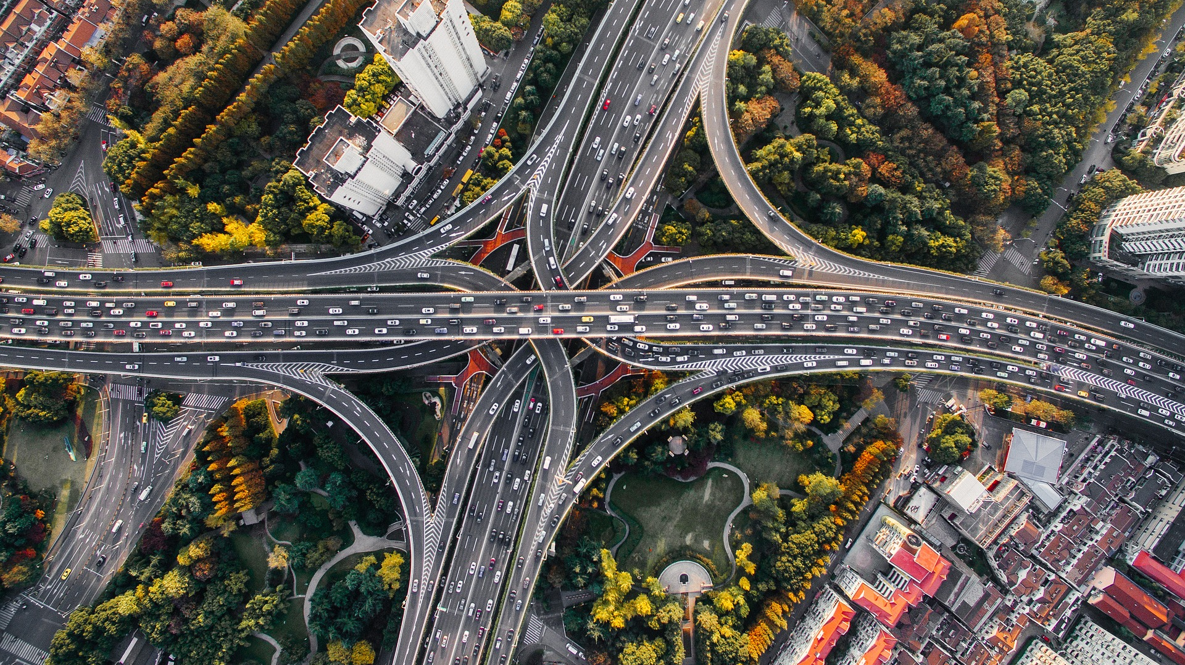
Montreal Road Collisions
http://donnees.ville.montreal.qc.ca/dataset/collisions-routieres

Slide 2
Contents
Introduction
Project Structure
Packaging and deployment
Data Cleaning
Exploratory Data Analysis
Restructuring data
Prediction
Questions

Slide 3

Introduction
The purpose of this project is to use acquired techniques.
In our project we will get use of:
Docker images and stacks
Volumes, containers
Spark Clusters
GCP
HDFS, MondoDB and Parquet
Pyspark, RDD.

Slide 4
Project Structure
Data:
accidents.csv
accidents_new.csv
municipalities.csv
final.csv
Code:
data_cleaning.ipynb
data_EDA.ipynb
csv-to-parquet.py
Write_features_MongoDB.ipynb
Prediction_Subset.ipynb
Prediction_and_model_export.ipynb
Packaging and Deploying:
Dockerfile
jupyter_local-compose.yml
jupyter_bind-compose.yml
jupyter-compose.ym
spark-compose.yml
spark_bind-compose.yml
spark_bind_hdfs-compose.yml
spark_hdfs-compose.yml
spark_mongo-compose.yml
Prediction Script:
pred.py
model.py

Slide 5
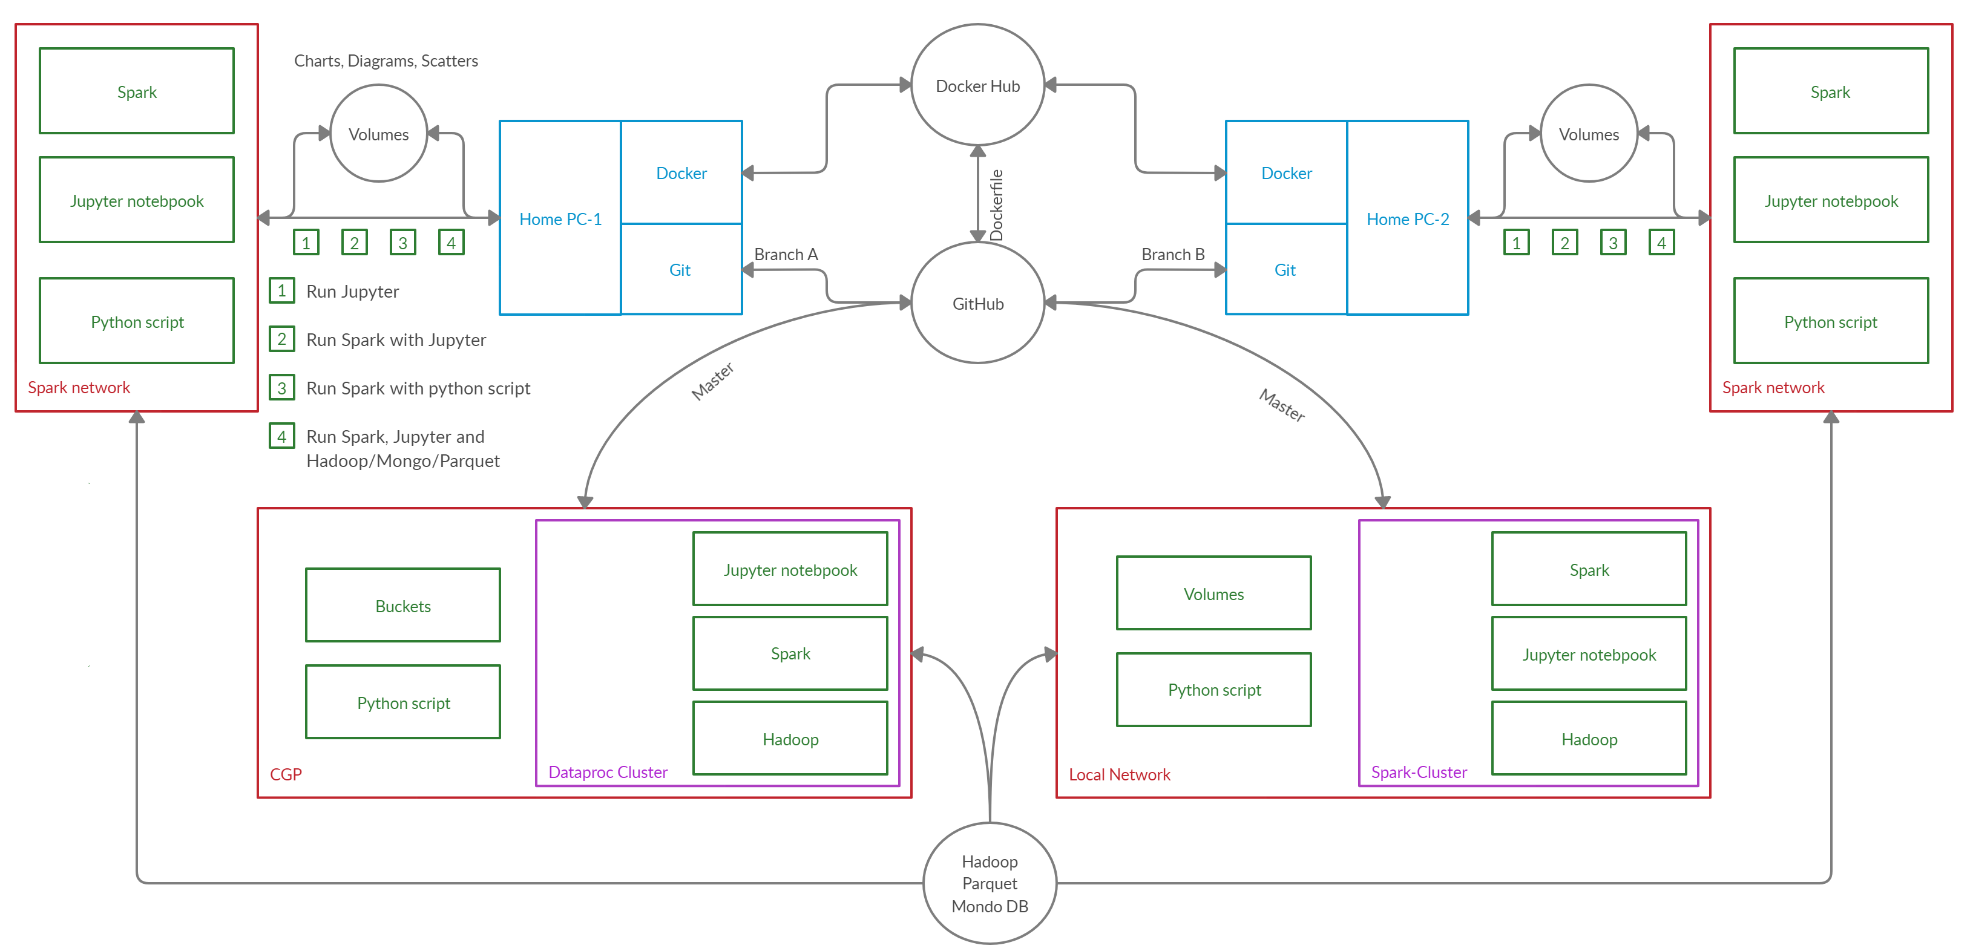
Packaging and deployment schema

Slide 6

Techniques used
Jupyter
Jupyter + Spark
Jupyter + Spark + Volumes
Spark + Parquet + Hadoop
Jupyter + Spark + MondoDB
GCP Dataproc cluster
Running script on a Spark cluster
Running script on a Spark cluster from an image

Slide 7

Data Cleaning
Reading the dataset and checking its structure.
Choosing some columns and renaming them.
Adjusting the types.
Reading municipalities dataset and merging it with collisions.
Exploring collisions in each municipality and doing some other basic explorations to better understand the data.
Dealing with nulls: removing all the rows with unknown categories anyway.
Writing the "clean" data to another csv file.

Slide 8

EDA
Understand the data through numerical and visual methods, by applying various data perspectives.
The goal is to find the features that will allow us to better understand our data and answer our questions.
This was done by the usage of:
Bar and Pie Charts
Heatmap
Aggregates

Slide 9
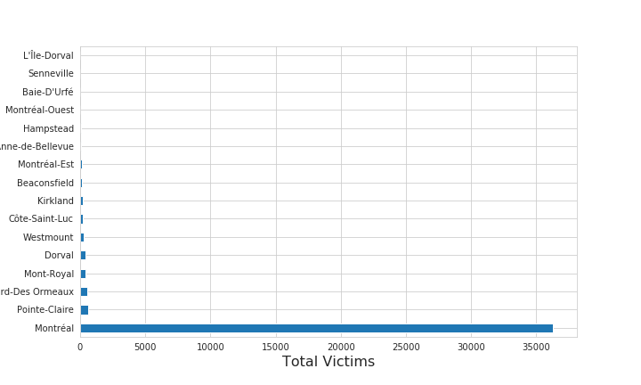
Bar Chart
Montreal has the largest number of victims.
L’île -Dorval has the minimum number of victims.
Notes:
Consider talking about:
Government
International development
Manufacturing
Healthcare
Education
Media
Insurance
Internet of Things (IoT)
Information Technology

Slide 10
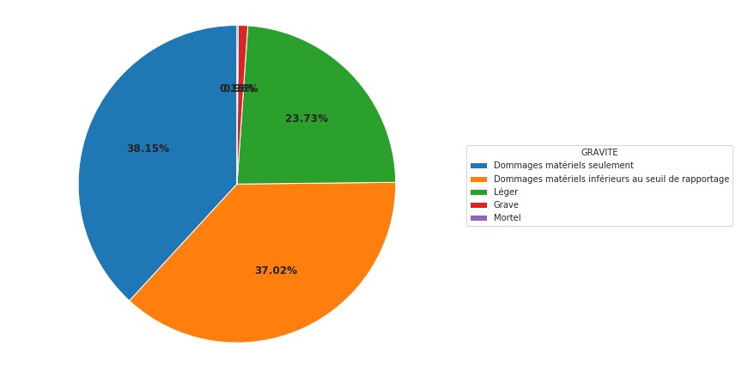
Pie Chart
Material Damages are the most common.
Notes:
Consider talking about:
Government
International development
Manufacturing
Healthcare
Education
Media
Insurance
Internet of Things (IoT)
Information Technology

Slide 11
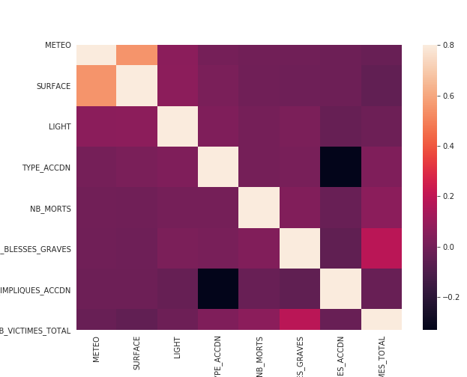
Heatmap
METEO (weather) has strong correlation with SURFACE.
Surface: State of the running surface during the accident (wet, dry, ice,..)
Notes:
Consider talking about:
Government
International development
Manufacturing
Healthcare
Education
Media
Insurance
Internet of Things (IoT)
Information Technology

Slide 12

Prediction Subject
Predict number of collisions in Montreal based on:
Lighting conditions
Day of the week
Month
Weather conditions

Slide 13

Restructuring Data
Original dataset:
one row = one collision
Needed:
one row= one day with the number of collision per day
divide each day into day and night in terms of lighting.

Slide 14
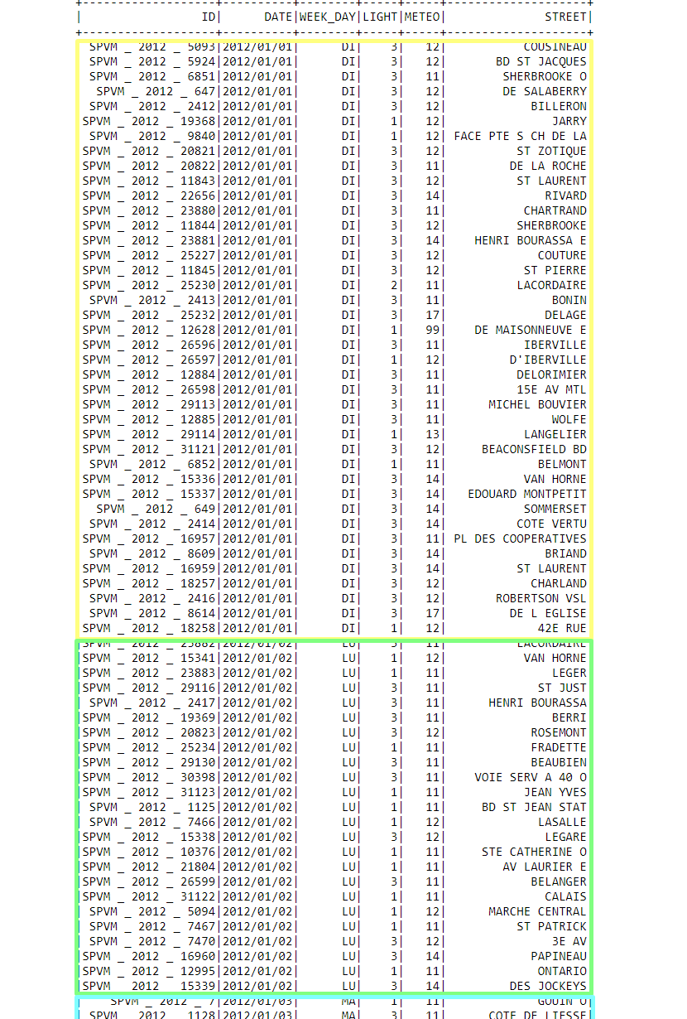
Original Dataset
collision - oriented structure
Notes:
Consider talking about:
Government
International development
Manufacturing
Healthcare
Education
Media
Insurance
Internet of Things (IoT)
Information Technology

Slide 15
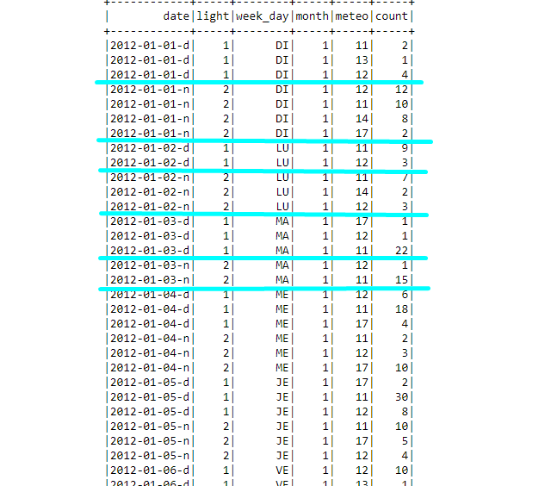
Intermediate Result
Day-oriented data with number of accidents, grouped by weather (meteo) condition.
Notes:
Consider talking about:
Government
International development
Manufacturing
Healthcare
Education
Media
Insurance
Internet of Things (IoT)
Information Technology

Slide 16
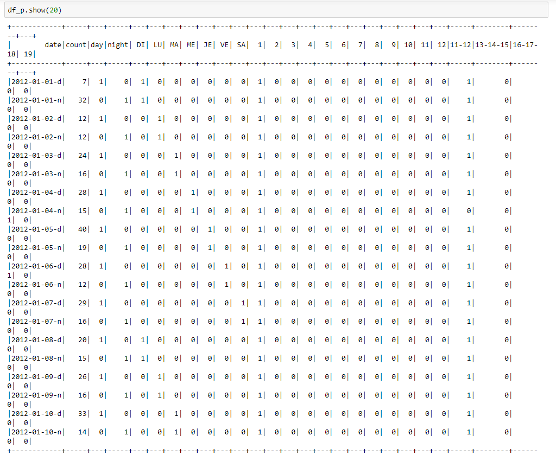
Final Dataset
Date - oriented structure
Notes:
Consider talking about:
Government
International development
Manufacturing
Healthcare
Education
Media
Insurance
Internet of Things (IoT)
Information Technology

Slide 17

Prediction and Results
We used Random Forest Regressor
Results are not good with CVS = 0.6 and MAE = 6.67
Possibly add some features using external sources or develop new features based on ratios or dependencies of existing features.
Strongest feature importance: Day, Night, Sunday, Saturday, Snow, January, December, Friday

Slide 18
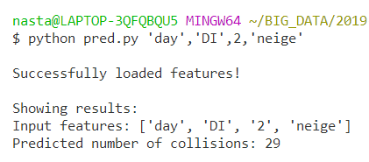
Predicting with specific features
Model exported using joblib library
Created a script that takes 4 arguments:
day/night
weekday
month
weather condition
Output: number of collisions

Slide 19

Questions?

Slide 20
Thank you!

